Slide 1

Software QUALITY ENGINERING
Software quality factors and attributes, software quality models

Slide 2


introduction
The quality of software products is now considered to be an essential element in business success. For some sensitive systems, the software quality is essential since the poor quality may cause tremendous human loss.

Slide 3

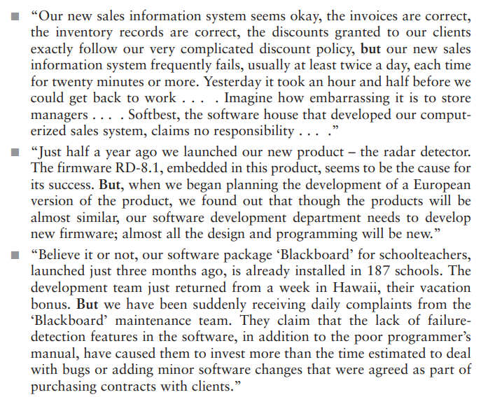

Slide 4
Common characteristic
All the software projects satisfactorily fulfilled the basic requirements for correct calculations (correct inventory figures, correct average class’s score, correct loan interest, etc.). All the software projects suffered from poor performance in important areas such as maintenance, reliability, software reuse, or training. The cause for the poor performance of the developed software projects in these areas was the lack of predefined requirements to cover these important aspects of the software’s functionality

Slide 5
The need for a comprehensive definition of requirements
To cover all attributes of software and aspects of the use of software, including usability aspects, reusability aspects, maintainability aspects, and so forth in order to assure the full satisfaction of the users. The various factors, which influence the software, are termed as software factors. They can be broadly divided into two categories. The first category of the factors is of those that can be measured directly such as the number of logical errors, and the second category clubs those factors which can be measured only indirectly. For example, maintainability but each of the factors is to be measured to check for the content and the quality control.

Slide 6
Classification of SQ Factors
McCall’s Factor Model
Classifies all software requirements into 11 factors.
The factors are grouped in 3 categories:
1. Product Operation Factors
Factors that deal with requirements that directly affect the daily operation of the software.
2. Product Revision Factors
Factors that deal with requirements that affect software maintenance.
3. Product Transition Factors
Factors that deal with requirements that affect the adaptation of software to other platforms, environments, interaction with other software.
Notes:
Jim McCall produced this model for the US Air Force and the intention was to bridge the gap between users and developers

Slide 7
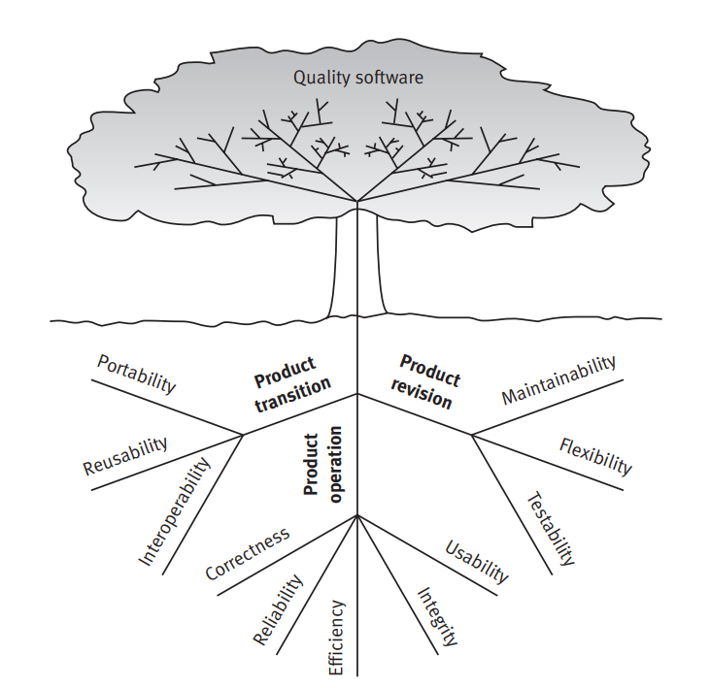
McCall’s Factor Model

Slide 8
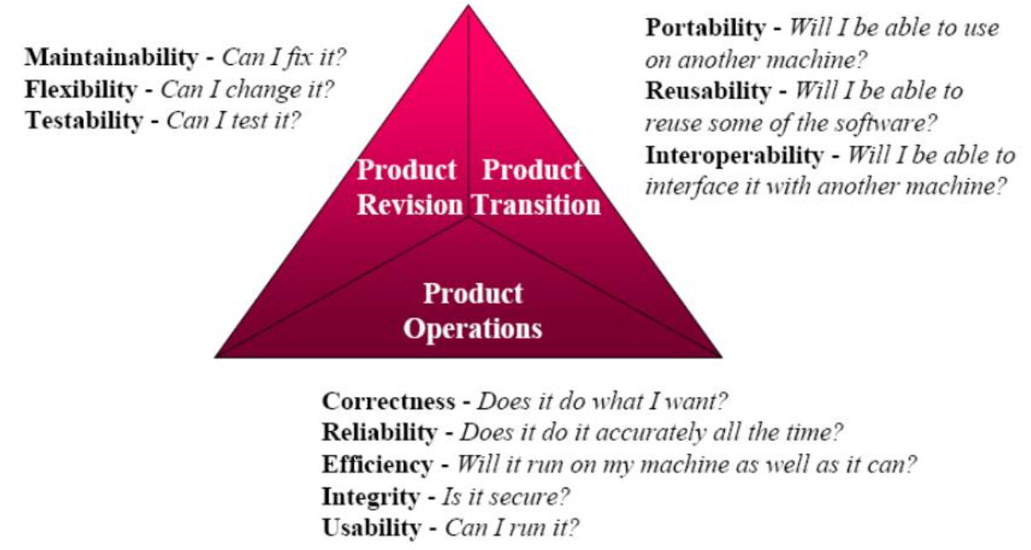
McCall’s Factor Model

Slide 9
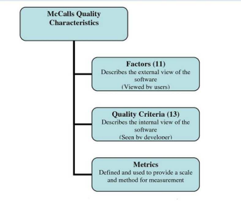
McCall’s Quality Model (1977)

Slide 10
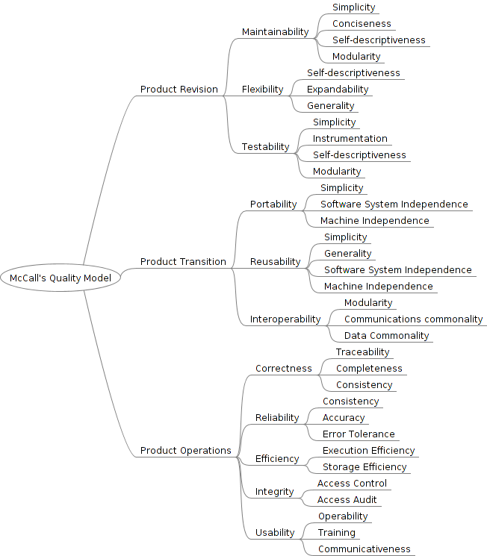
Factors division
Matrices

Slide 11
Alternative models of software quality factors
Two factor models, appearing during the late 1980s, considered to be alternatives to the McCall classic factor model (McCall et al., 1977), deserve discussion: 1. The Evans and Marciniak factor model (Evans and Marciniak, 1987). 2. The Deutsch and Willis factor model (Deutsch and Willis, 1988).

Slide 12
Formal comparison of the alternative models
A formal comparison of the factor models reveals: 1. Both alternative models exclude only one of McCall’s 11 factors, namely the testability factor. 2. The Evans and Marciniak factor model consists of 12 factors that are classified into three categories. 3. The Deutsch and Willis factor model consists of 15 factors that are classified into four category

Slide 13
five new factors
Totally five new factors were suggested
Evans and Marciniak offer two ‘new’ ones:
Verifiability and Expandability
Deutsch and Willis offer three ‘new’ ones:
Safety
Manageability, and
Survivability

Slide 14
Comparison of McCall’s factor model and alternative models

Slide 15
ALTERNATIVES
Evans and Marciniak offer Verifiability and Expandability
1. Verifiability Requirements addresses design and programming features that allow for efficient verification of design and programming;
This does not refer to outputs; rather, structure of code; design elements and their dependencies, coupling, cohesion; patterns…
apply to modularity, simplicity, adherence to documentation and programming guidelines, etc.
2. Expandability Requirements really refers to scalability and extensibility to provide more usability.
Essentially this is McCall’s flexibility

Slide 16
Alternatives
Deutsch and Willis offer Safety, Manageability, and Survivability
1. Safety Requirements address conditions that could bring the equipment or application down especially for controlling software, as in setting alarms or sounding warnings.
Especially important to process control / real time software such as that running conveyor belts or instrumentation for ordinance…
2. Manageability Requirements refer to tools primarily administrative to control versions, configurations and change management / tracking.
We must have tools to manage versions and various configurations that may vary from customer to customer.
3. Survivability Requirements refer to MTBF, or continuity of service, as well as MTTR (mean time to recover).
Appears to be quite similar to Reliability in McCall’s model

Slide 17
Comparisons
These all are pretty close.
Both models do add Verifiability,
I like this one; addresses design and programming. (programming conventions / standards, etc.)
As we have developed as a discipline, I think this is essential.
Safety is clearly important as computers control more and more of what we do especially in both hardware and in software.
New cars will now sound an alarm as we back up; software will sound when power is interrupted. This is important.

Slide 18
SO, WHO CARES?
Both developers and clients need to care. One group may care more than the other for certain quality factors.
Certainly, the nature of the app dictates more concern on some of these factors than others (safety, for example)
In the Rational Unified Process, we call this component of the requirements the SRS (software requirement specifications, which contains these ‘non-functional requirements’ which are requirements in every sense of the word – just not functional requirements, as the term is normally used.

Slide 19

END OF LECTURE
Any Questions !!!

